Slide 1

Software Architecture And Design
Sec.1
Eng. Al-hassan Mohamed
Eng. Mariam Malak

Slide 2

AGENDA
Agenda
Software architecture
Flask
Environment setup
Small program (‘hello world’)

Slide 3
Software architecture
Software architecture is like the blueprint for building software, showing how different parts fit together and interact.
It helps the development team understand how to build the software according to customer requirements.
There are many ways to organize these parts, called software architecture patterns.
These patterns have been tested and proven to solve different problems by arranging components in specific ways.
Without a clear and well-defined architecture, most developers and architects will resort to the de facto standard traditional layered architecture pattern (also called the n-tier architecture), creating implicit layers by separating source-code modules into packages.
what often results from this practice is a collection of unorganized source-code modules that lack clear roles, responsibilities, and relationships to one another.
[This is commonly referred to as the big ball of mud architecture anti-pattern. ]

Slide 4
What is a software architecture?
Software Architecture is a high-level structure of the software system that includes the set of rules, patterns, and guidelines that dictate the organization, interactions, and the component relationships.
It serves as blueprint ensuring that the system meets its requirements and it is maintainable and scalable.
Software architecture benefits:
Modularity: Software Architecture divides system into interchangeable components that can be developed, tested, and maintained independently.
Encapsulation: It helps to hide the details of the components, exposing only the necessary information, thus reducing the complexity of the system.
Security: It helps to incorporate measures to protect the system against the unauthorized access.
Documentation: Provides clear documentation of the system architecture, thus facilitating communication and better understanding of the system.
Performance: Software architecture helps to make sure that the system meets the required performance metrics such as resource utilization, throughput, etc.

Slide 5
Software Architecture Pattern vs Design Pattern
Features | Software Architecture Pattern | Design Pattern
Definition | This is a high-level structure of the entire system. | This is a low-level solutions for common software design problems within components.
Scope | Broad, covers entire system. | Narrow, focuses on individual components.
Purpose | Establish entire system layout. | Provide reusable solutions for the recurring problems within a systems' implementation.
Focus | System stability, structural organization. | Behavioral and structural aspects within components.
Documentation | It involves architectural diagrams and high-level design documents. | It includes UML diagrams, detailed design specifications.
Examples | Layered Architecture, Microservices, Client-Server. | Singleton, Factory, Strategy, Observer.

Slide 6
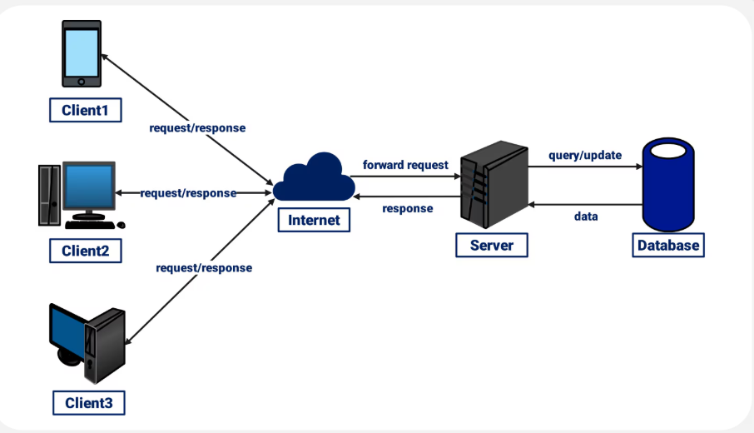
Types of Software Architecture Patterns
1. Client-Server Architecture Pattern:
The client-server pattern has two major entities. They are a server and multiple clients. Here the server has resources(data, files or services) and a client requests the server for a particular resource. Then the server processes the request and responds back accordingly.
Advantages:
Centralized Management: Servers can centrally manage resources, data, and security policies, thus simplifying the maintenance.
Scalability: Servers can be scaled up to handle increased client requests.
Security: Security measures such as access controls, data encryption can be implemented in a better way due to centralized controls.
Disadvantages:
Single Point of Failure: Due to centralized server, if server fails clients lose access to services, leading loss of productivity.
Costly: Setting up and maintaining servers can be expensive due to hardware, software, and administrative costs.
Complexity: Designing and managing a client-server architecture can be complex.
Advantages:
1. Scalability: Individual layers in the architecture can be scaled independently to meet performance needs.
2. Flexibility: Different technologies can be used within each layer without affecting others.
3. Maintainability: Changes in one layer do not necessarily impact other layers, thus simplifying the maintenance.
Disadvantages:
Complexity: Adding more layers to the architecture can make the system more complex and difficult to manage.
Performance Overhead: Multiple layers can introduce latency due to additional communication between the layers.
Strict Layer Separation: Strict layer separation can sometimes lead to inefficiencies and increased development effort.

Slide 7
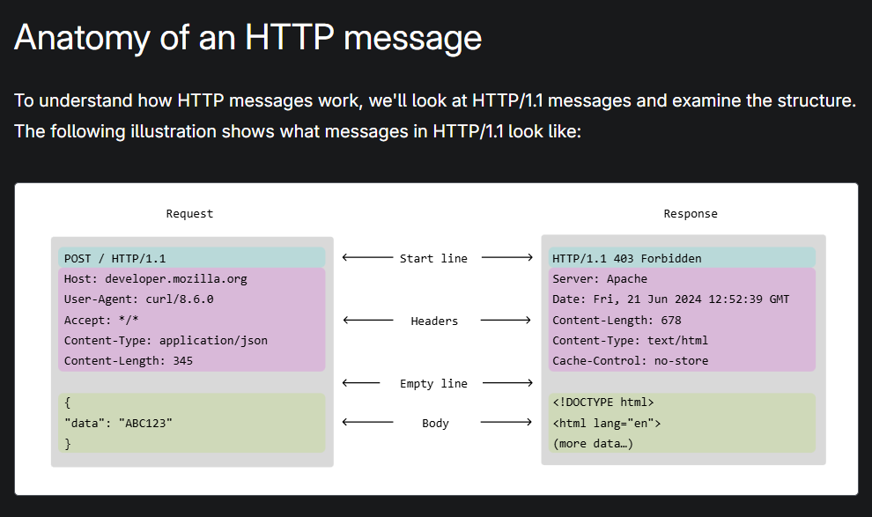
Http message
HTTP messages - HTTP | MDN

Slide 8
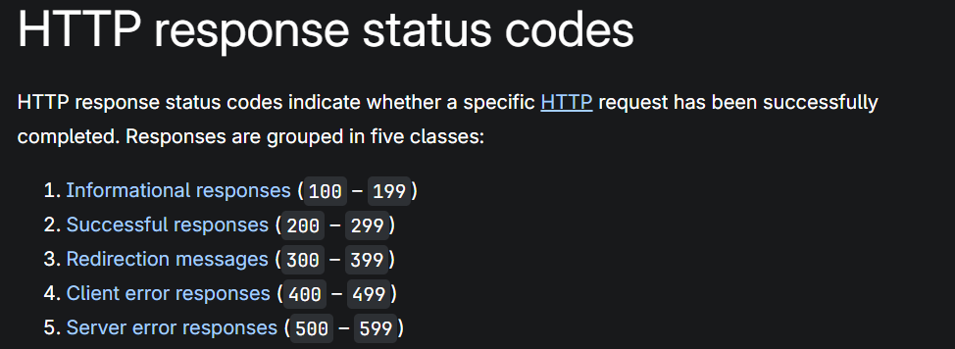
Http status code
200→ ok
201→ created [POST,PUT]
400 → Bad request
401 → Unauthorized
404 → Not found
500 → Interna server error
[HTTP response status codes - HTTP | MDN]

Slide 9
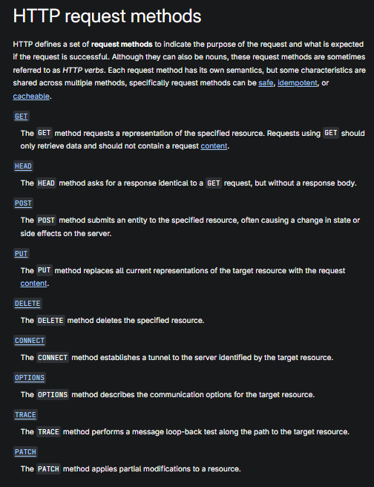
Http request methods
HTTP request methods - HTTP | MDN

Slide 10
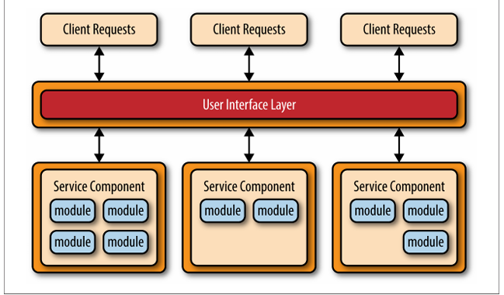
Types of Software Architecture Patterns
2. Microservices Architecture Pattern
The collection of small services that are combined to form the actual application is the concept of microservices pattern. Instead of building a bigger application, small programs are built for every service (function) of an application independently
One common concept that applies to the general architecture pattern is the notion of separately deployed units.
each component of the microservices architecture is deployed as a separate unit, allowing for easier deployment through an effective and streamlined delivery pipeline, increased scalability, and a high degree of application and component decoupling within your application.
Rather than think about services within a microservices architecture, it is better to think about service components, which can vary in granularity from a single module to a large portion of the application
Another key concept within the microservices architecture pattern is that it is a distributed architecture, meaning that all the components within the architecture are fully decoupled from one other and accessed through some sort of remote access protocol
Advantages:
1. Scalability: Individual layers in the architecture can be scaled independently to meet performance needs.
2. Flexibility: Different technologies can be used within each layer without affecting others.
3. Maintainability: Changes in one layer do not necessarily impact other layers, thus simplifying the maintenance.
Disadvantages:
Complexity: Adding more layers to the architecture can make the system more complex and difficult to manage.
Performance Overhead: Multiple layers can introduce latency due to additional communication between the layers.
Strict Layer Separation: Strict layer separation can sometimes lead to inefficiencies and increased development effort.
Notes:
Solved the problem of monolithic applications by separating the application into multiple deployable units (service components) that can be individually developed, tested, and deployed independent of other service components

Slide 11
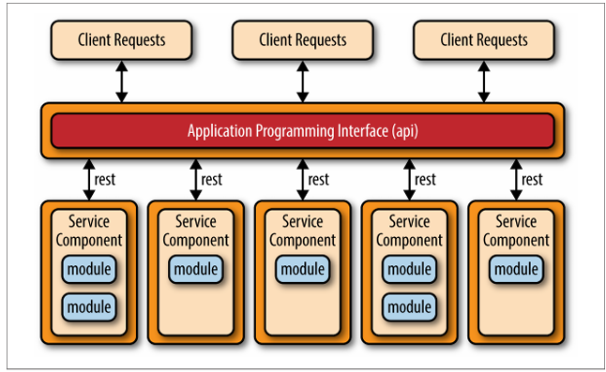
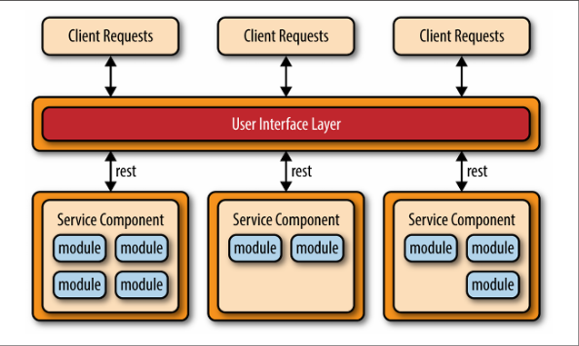
Types of Software Architecture Patterns
API REST-based:
The API REST-based topology is useful for websites that expose small, self-contained individual services through some sort of API (application programming interface).
This topology consists of very fine-grained service components (hence the name microservices) that contain one or two modules that perform specific business functions independent from the rest of the services.
These fine-grained service components are typically accessed using a REST-based interface implemented through a separately deployed web-based API layer.
Application REST-based:
The application REST-based topology differs from the API REST based approach in that client requests are received through traditional web-based or fat-client business application screens rather than through a simple API layer
The user-interface layer of the application is deployed as a separate web application that remotely accesses separately deployed service com ponents (business functionality) through simple REST-based interfaces.
Advantages:
1. Scalability: Individual layers in the architecture can be scaled independently to meet performance needs.
2. Flexibility: Different technologies can be used within each layer without affecting others.
3. Maintainability: Changes in one layer do not necessarily impact other layers, thus simplifying the maintenance.
Disadvantages:
Complexity: Adding more layers to the architecture can make the system more complex and difficult to manage.
Performance Overhead: Multiple layers can introduce latency due to additional communication between the layers.
Strict Layer Separation: Strict layer separation can sometimes lead to inefficiencies and increased development effort.
Notes:
Solved the problem of monolithic applications by separating the application into multiple deployable units (service components) that can be individually developed, tested, and deployed independent of other service components

Slide 12

Flask

Slide 13
flask
Flask is a lightweight web application framework for Python.
Flask is a WSGI (Web Server Gateway Interface) web application framework written in Python.
Flask is designed to be simple, flexible, and minimal, giving developers the essentials for building web applications without enforcing a rigid structure.
Key characteristics:
Microframework: Provides only the core features (routing, request handling, templating). Developers add extensions for things like databases, authentication, or form handling.
Flexibility: You decide how to structure your app; Flask doesn’t impose strict conventions.
Scalability: While minimal, it can scale up to complex applications with the right extensions.
Ease of Use: Quick to get started, making it popular for prototypes, small apps, and learning web development.

Slide 14
Environment setup & Small program (‘hello world’)

Slide 15
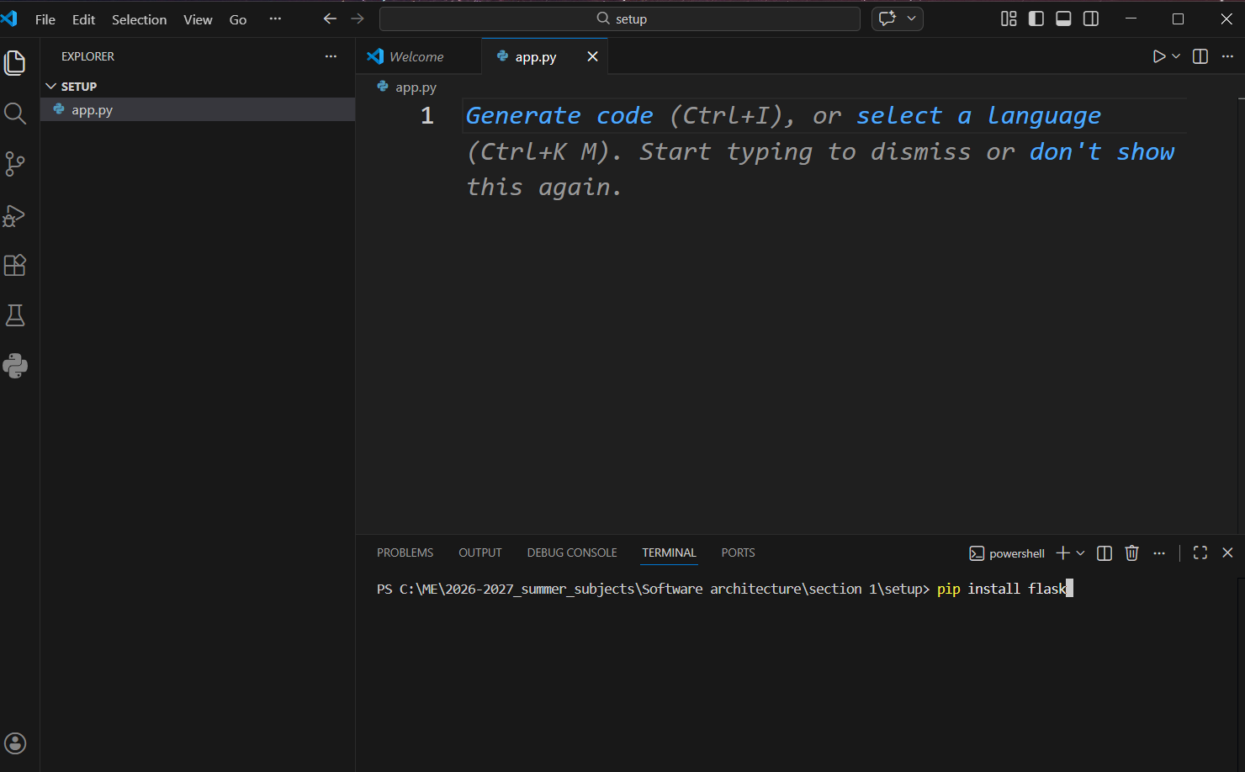
flask
Downloading package
For project only:

Slide 16
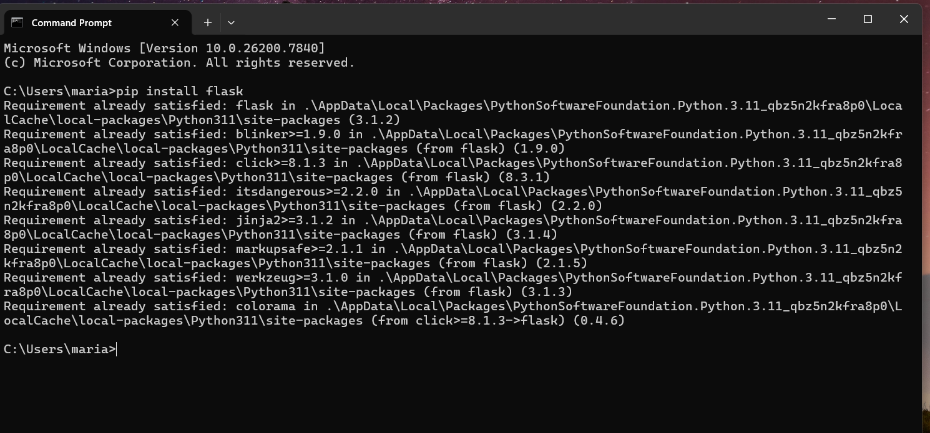
flask
Downloading package
Globally :

Slide 17
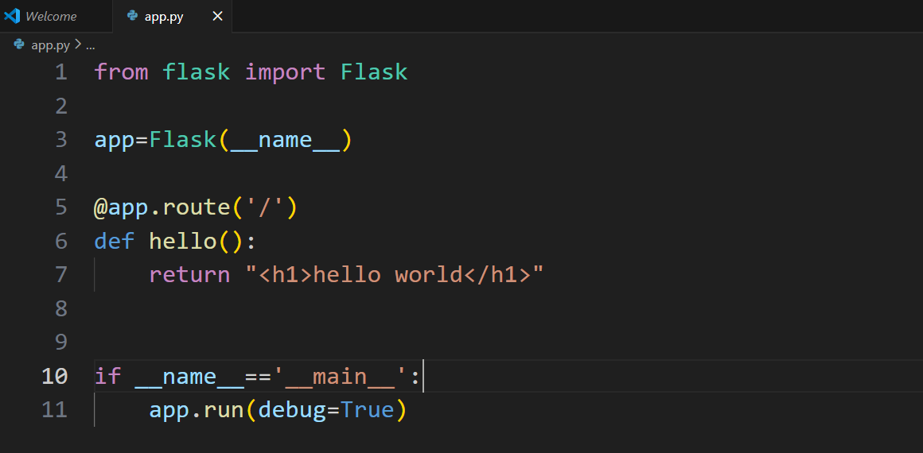
flask
2. Creating project :
Create folder in any place
Open VS code
Open folder you've created
Create file in it ‘app.py’
Write the following :

Slide 18
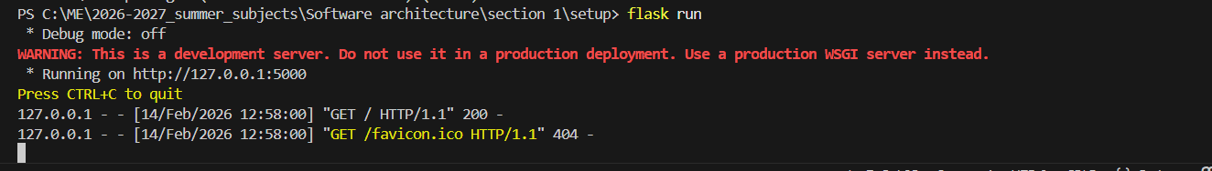
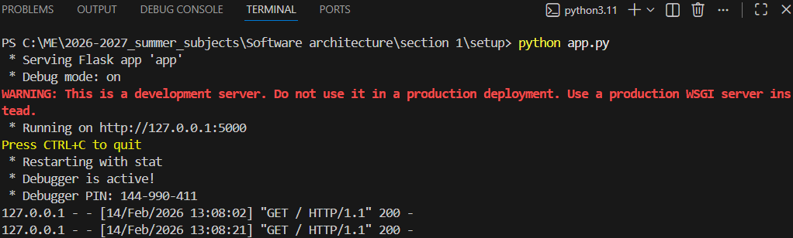
flask
3. Run it :
In terminal:
flask run
Python app.py

Slide 19
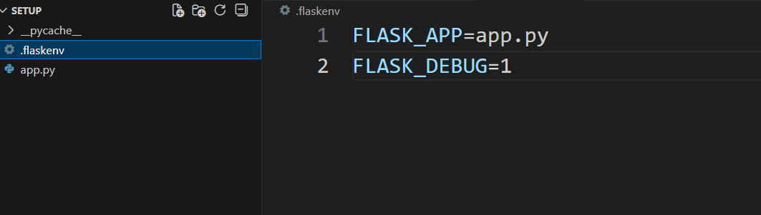
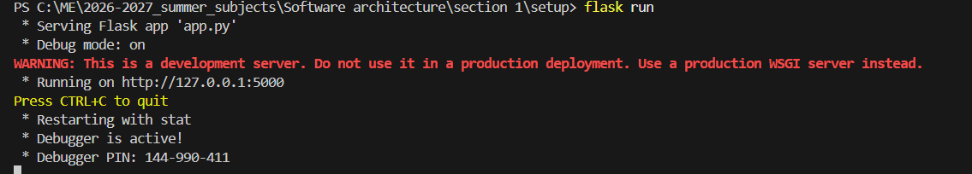
flask
Note:
To activate debugging mode with [flask run] command [it’s already working with python app.py command]:
Create a file and name it → .flaskenv
Add these lines to it :
FLASK_APP=app.py (your file name)
FLASK_DEBUG=1

Slide 20

THANK YOU

